Slide 1

Lecture 0: Introduction to Digital Technologies and Digital Transformation
Ravi Mittal
ravi.mittal@iitgoa.ac.in
Indian Institute of Technology, Goa

Slide 2
Contents
What is Digital?
Why digital technologies
Thing → Computer Thing
Advantages of Scale, Scope, and Speed
What is Digital Transformation?

Slide 3
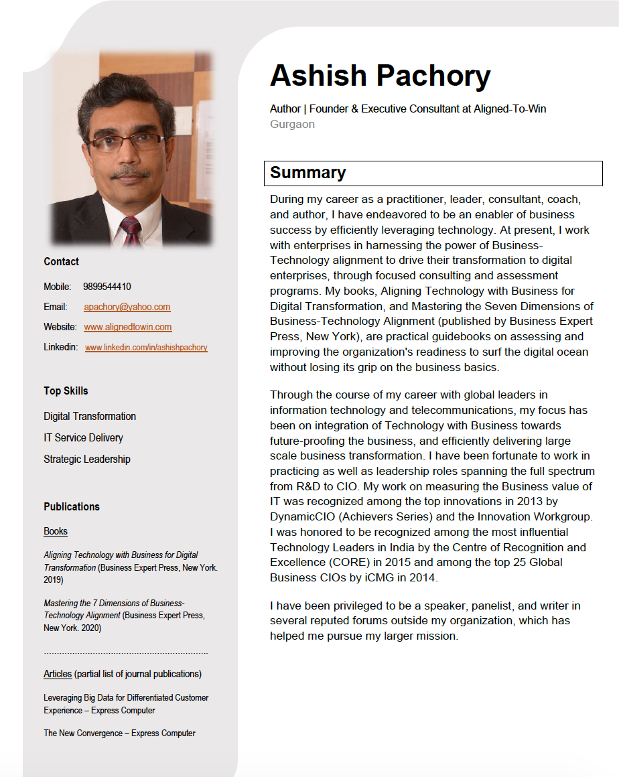
About Instructors

Slide 4
About Instructors
Ravi Mittal
Check my Linkedin page.

Slide 5
What is Digital?

Slide 6
What is Digital ?
Electronic technology that generates, stores, and processes data in terms of two states: positive and non-positive
Positive is expressed as number 1 and non-positive is expressed as number 0
We can also express positive as “True” and non-positive as “False”
We can express any logical function in terms of 0s and Is using logical functions
Discrete values; varies abruptly
Data is stored and communicated as a string of 0s and 1s

Slide 7
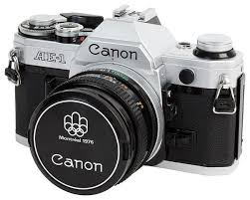
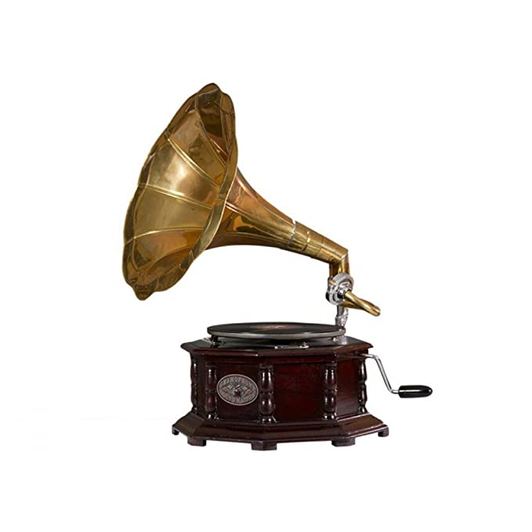

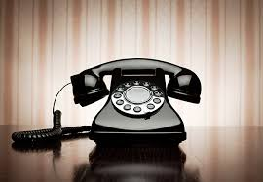
What is Non-Digital?
Non-digital is known as Analog
In analog technology, data is coded through continuous signal of varying frequency or amplitude
Analog signal technology is in use for over a century
Plain Old Telephone
Radar
Cassette tape player

Slide 8
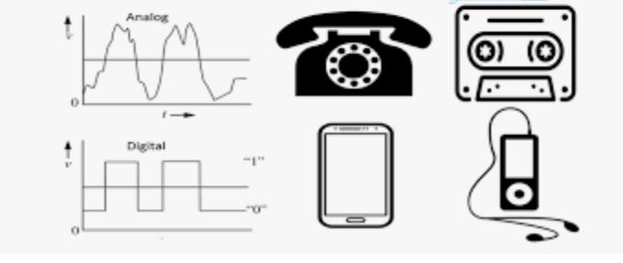
Analog Vs Digital

Slide 9


Analog and Digital Signal
Analog Signal: Varies Continuously
Digital Signal: Discrete values, varies abruptly

Slide 10
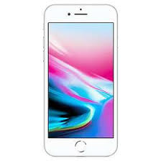
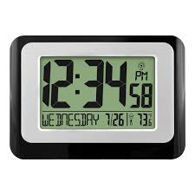
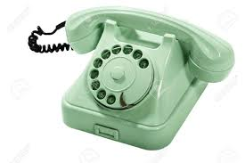
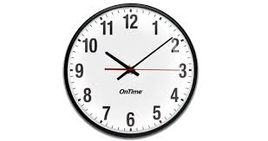

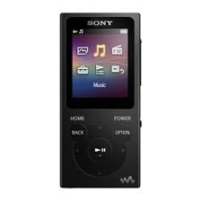
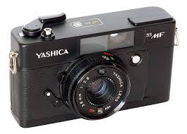
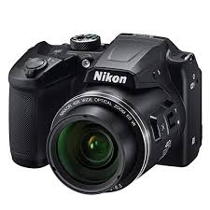
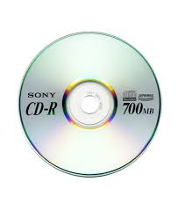
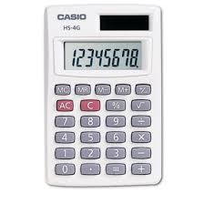
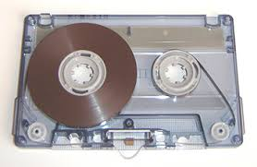
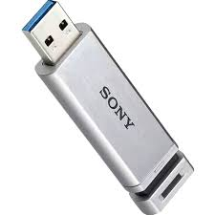

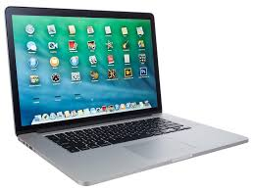
Analog Tech → Digital Tech
?

Slide 11
Why Digital Technologies?

Slide 12
Why Digital Technology?
Storage Advantages
High density → Few Terabytes of data can be stored in a home device
Easy to recover from errors
Easy to copy
Storage is more durable → can be retained for long time
Computing advantages
Moore’s law
Processors are becoming more and more powerful with time
Information is easy to manipulate

Slide 13
Why Digital Technology?
Communication Advantages
Very high speed of communication (higher bandwidth)
A single fiber can carry 100’s of terabyte of data
Low signal degradation with distance
Signals can be regenerated
Less resistance to interference (noise)
The Internet has become possible …
Low cost
Low cost due to many factors: High degree of integration, easy to design and replicate
High Flexibility

Slide 14
Why Digital Technologies?
Easy to design
Higher precision rate in terms of accuracy
High Flexible
Computer based digital systems can be controlled remotely
Computer based digital systems can be easily updated or modified to add new functionality
High reliability
Digital systems can be made fault-tolerant
Easy to recover from errors
Software can be remotely (and automatically) updated
It is easy to attach a small computer (microcontroller or microprocessor) to any non-digital device so as to
Enhance its features and capabilities
Manageability, Controllability, Maintainability

Slide 15
Thing → Computer Thing

Slide 16
Everything is becoming Digital and Intelligent

Slide 17
Everything is becoming smart
Earlier things had computer in them
Now, computer have things attached to them
Computers are becoming smaller, cheaper, and more powerful. Internet connectivity is almost free
Manufactures are making everything smart
Do you notice that you are buying computers with things attached to them?
If not, start doing it now

Slide 18
Smart things with Internet connectivity
Modern Pacemakers and Insulin pumps are smart with Internet connectivity
Pills are smart controlled by Internet
Fitness tracker are smart with Internet connectivity
Everything is becoming smart: toys, pens, toothbrush, coffee cup, Barbie doll, smart sensors for plants, a smart motorcycle helmet, a smart toilet, a smart bed, smart lock
Smart office space with automatic controls: light, temperature, elevator

Slide 19
Reasons for “Smart trend”
Market economics → customers demand smart things → mass production of general purpose chips, sensors, computing systems
Things can be remotely controlled, accessed, secured, and “data collected”
Additional features
Advantages of hyper connectivity
As more and more things get interconnected, collective benefits become multifold

Slide 20
Advantages of Scale, Scope and Speed

Slide 21
Scale, Scope, and Speed - Scale
Traditional companies expanded their business linearly – steady and progressive expansion
New stores, new products, new factories, new territories
Digital companies grow exponentially
Uber, Airbnb, Netflix, Google not only grew exponentially, but also amassed detailed data on their operations and customers
Scale includes not only sales growth but digital intelligence around it

Slide 22
Scale, Scope, and Speed - Scope
Apple: PC seller → PC, Laptop, Mobile, Pad, Apple TV, Watch, and Music
Google: Search → Mobile web (Android), YouTube, Automobiles, health-care, Maps, Google Play Movies and TV, WiFi Routers
Amazon: ecommerce book seller → online e-retailer → Cloud → Amazon Prime
These companies use:
data analytics – to know their customers
Machine learning and AI – take advantage of huge volume of data and sift it, sort it, analyze it →expand the scope with new products and markets (even in unrelated industries)
Payment gateway vendors start selling Mutual funds
Tracking of customers and adjusting offerings quickly

Slide 23
Scale, Scope, and Speed - Speed
Mark Zukerberg’s motto: Move fast and break things.. Unless you are not breaking things, you are not moving fast enough”
Continuous iterations and improvements
Google deploy products in the open and keeps adding new features on daily or weekly basis
Closely observe how customers use it
Customers become trusted co-developers
Tesla maintains and upgrades its cars over-the-air software updates – Continuous maintenance with speed
Companies that meet the needs of their customers faster than competitors grow faster and more profitable
Time is competitive weapon
Speed is possible with Digital Technologies

Slide 24
Scale, Scope, and Speed - Speed
Faster product design and development, manufacturing, and supply chain synchronization
Back office must speedup the back-office processes
The slowest process in the organization define your speed
Need to calibrate the speed of your delivery to the benchmark set by companies born in the digital era
Great Advantage – Reuse and extension of existing solutions

Slide 25
Advantages of (Scale + Scope + Speed)
Scale and Scope: define company’s strategic ambition
What set of businesses should we operate and at what scale ?
Scale at Speed: fast-mover advantage
Limited by company’s internal organizational processes and systems
Changing scope at Speed
Launching new products
Tapping into scarce resources: interconnected data, patents, talents, R&D projects
Challenge is not in competing with old incumbents but with newer-age companies that are aiming to disrupt and transform your industry

Slide 26
What is Digital Transformation?

Slide 27
Digital Transformation Definitions – Many definitions
Enterprise wide change enabled through technology
Leverage digital technologies to enable innovation of the business and operating models
Digital Transformation is the transformation of business and organizational activities, processes, competencies and models to fully leverage the main features of digital technologies: Scale, Scope, and Speed
Digital transformation is the process of using digital technologies to create new — or modify existing — business processes, culture, and customer experiences to meet changing business and market requirements

Slide 28
Course Contents - 1
Introduction to Digital Technologies and their applications in Digital Transformation. We will cover following topics
Evolution of Processor Technology (Moore’s law etc)
Evolution of Communication/Networking Technologies
Local Area Networks
Internet Technologies
Datacenter and Cloud Computing
Internet of Things (IoT)
Mobile Technologies
Blockchain and Bitcoin
Data Analytics
AI and Deep Learning
Cyber Security

Slide 29
Course Contents -2
Digital Transformation Methodologies
ICT Evolution and Adoption
The Digital Economy
What is Digital Transformation (Characteristics of a digital enterprise)?
Business-Technology Alignment
Digital Culture and Mindset
Digital Business Process and Change Management
Technology Drivers of the Digital Enterprise – 1
Technology Drivers of the Digital Enterprise – 2
Customer Experience Management
Building blocks of the Digital enterprise
Disruptive Innovation – tools, techniques, and examples
Digital Transformation Model – from current state to end state
DX Case Studies
DX Project presentation (exercise for students)

Slide 30
About Grading
1 End-term exam (20%)
1 Mid-term exam (20%)
Class attendance and Attentiveness (20%)
Project and assignments (40%)

Slide 31
Lecture Summary
In the last 5 decades or so, there has been a lot advancements and innovations in digital technologies
There are many advantages of digital technologies: simplicity, easy to manipulate (calculations), easy to storage, easy to communicate etc
Analog (non-digital) things are becoming Computer-Things
There has been tremendous progress in computing and communication technologies – resulting in businesses adopting use of digital technologies for their advantages – scope, scale, and speed of doing business

